Slide 1
Smart Alarms
Cláudia Almeida | Dulce Campos | Isabel Fernandes
Marta Cunha | Sofia Silva
Innovation & Enterpreneurship December 2017

Slide 2
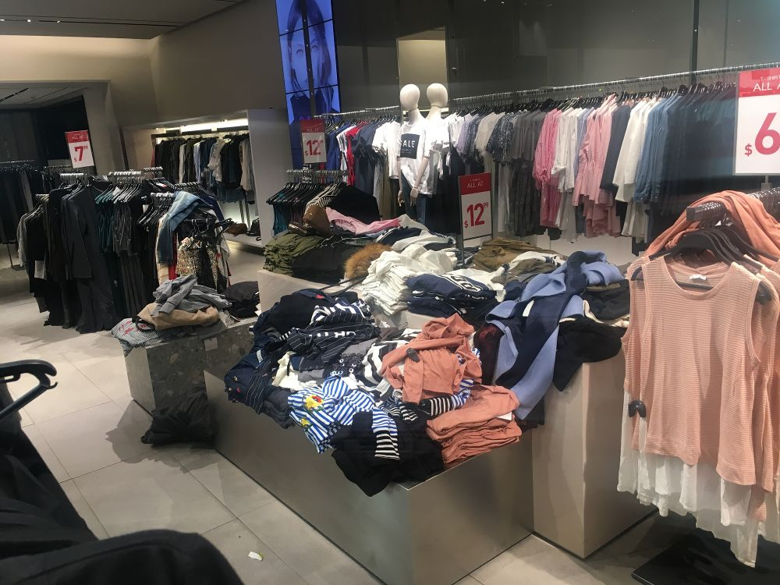
Problem
Misplaced items in a store;
Other improvements: keeping track of the stock and theft.
PT:0.90% WORLD:1.23%
Source of unknown losses:
Portugal
Source: https://www.elconfidencial.com/sociedad/2016-09-04/espana-mangar-robos-seguridad-tiendas-hurtos_1254026/
1
Notes:
Percentagens do rendimento líquido.

Slide 3
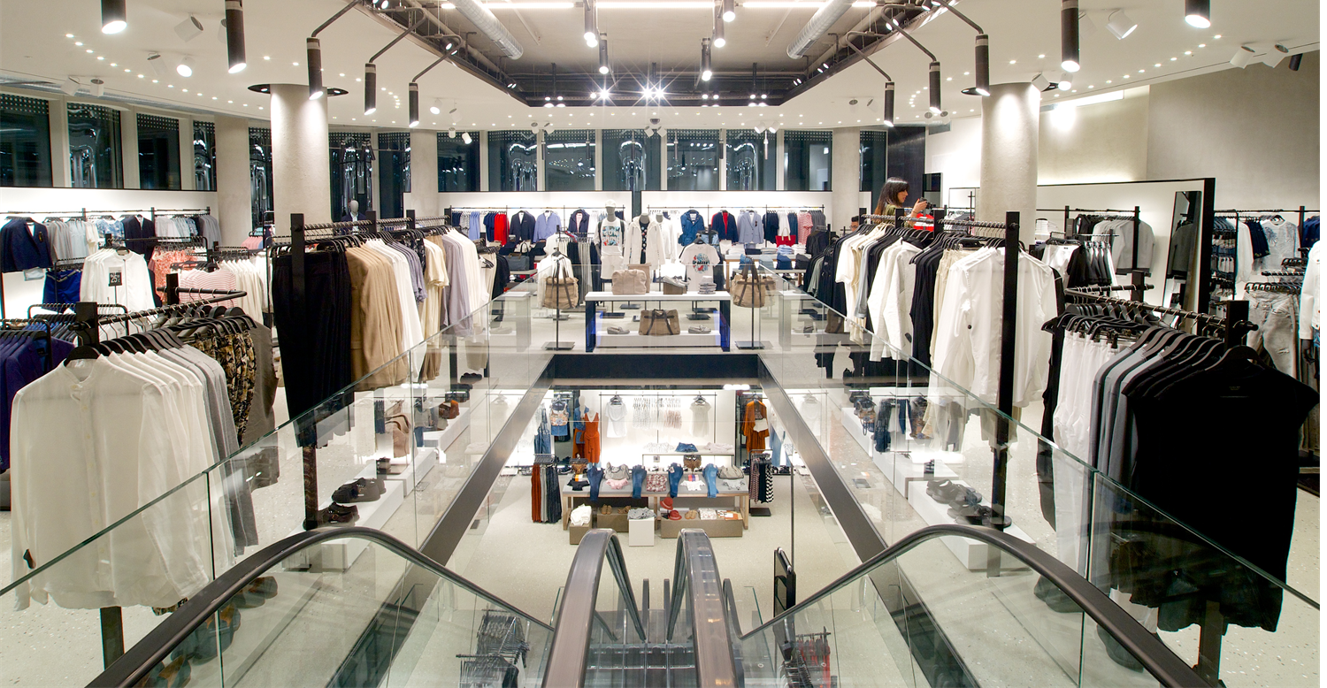
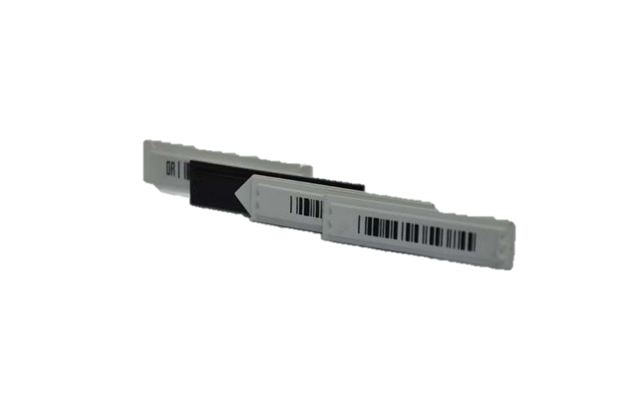
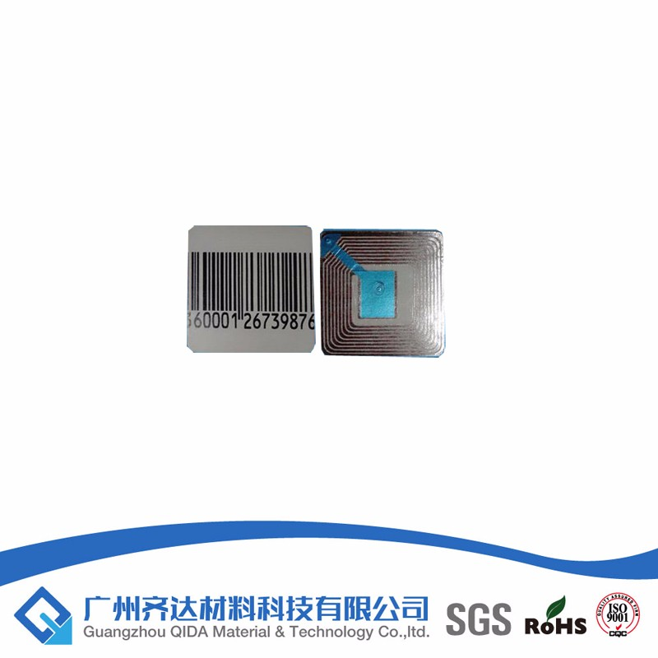
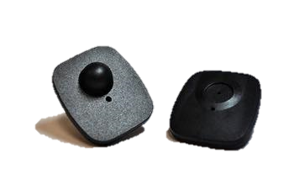
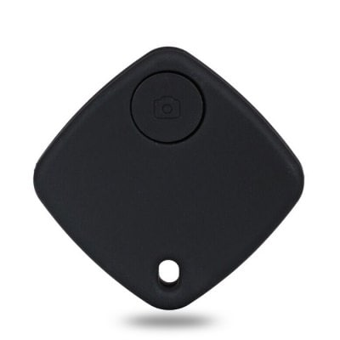
Solution
Incorporation of a locator in the alarm system.
2

Slide 4
Value Proposition
For stores of big dimension who have trouble keeping the store organized our Smart Alarms provides a way of locating items in a stores unlike the conventional alarm system.
3

Slide 5
Smart Alarms
Perceptual Map
EAS Systems
4

Slide 6
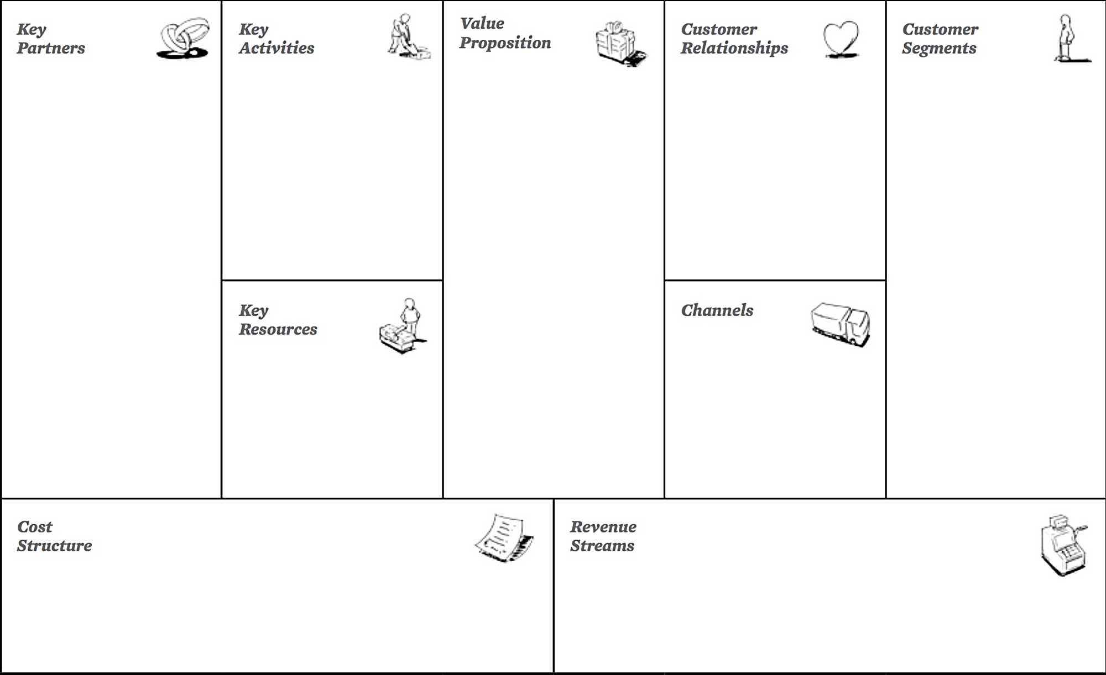
Innovation and development of the product;
Production;
Expedition;
Sales.
For stores of big dimension who have trouble keeping the store organized our Smart Alarms provides a way of locating items in a stores unlike the conventional alarm system.
Get: offer 1 000 Smart Alarms for test;
Keep: Warranty; maintenance/replacement services;
Grow: Improvement of the technology;
Lowering of prices due to mass production.
Raw materials providers;
EDP;
Águas de Portugal;
Distributors.
Retailers of all kinds:
Apparel stores;
Bookstores;
Electronic device stores;
Liquor stores.
The Business Model Canvas
Smart Alarms
Improvement of the stock’s tracking;
Manufacturing;
Software developers;
Engineering;
Patents;
Quality control.
Technological fairs;
Direct sales supported by a website (for renowal).
Combat theft;
Long durability and reusable.
Fixed costs:
Variable costs:
Direct sales (software licensing + security tag or label);
Customer support services (repair, maintenance and replacement ).
Raw material;
Energy;
Storage;
Team wages;
Rent;
Workers insurance.
5

Slide 7
Market
TAM :
5926 Retailers
Total Available Market (TAM)
Apparel stores;
Bookstores;
Electronic device stores;
Liquor stores.
Sources: https://www.thebalance.com/us-retail-industry-overview-2892699/
https://www.statista.com/statistics/443522/global-retail-sales/
http://www.retail-index.com/HomeSearch/CalculateNumberofRetailerspercountrysector.aspx
7

Slide 8
Market
TAM :
5926 Retailers
Total Available Market (TAM)
TAM
SAM - Worldwide Inditex:
7405 Stores
Served Available Market (SAM)
Sources: https://www.thebalance.com/us-retail-industry-overview-2892699/
https://www.statista.com/statistics/443522/global-retail-sales/
http://www.retail-index.com/HomeSearch/CalculateNumberofRetailerspercountrysector.aspx
8

Slide 9
Market
TAM :
5926 Retailers
Total Available Market (TAM)
TAM
SAM
SAM - Worldwide Inditex:
7405 Stores
Served Available Market (SAM)
Sources: https://www.thebalance.com/us-retail-industry-overview-2892699/
https://www.statista.com/statistics/443522/global-retail-sales/
http://www.retail-index.com/HomeSearch/CalculateNumberofRetailerspercountrysector.aspx
Target Market
(TM)
TM – Inditex in Portugal:
337 Stores
9

Slide 10

Market
TAM :
5926 Retailers
Total Available Market (TAM)
TAM
SAM
SAM - Worldwide Inditex:
7405 Stores
TM
Served Available Market (SAM)
Sources: https://www.thebalance.com/us-retail-industry-overview-2892699/
https://www.statista.com/statistics/443522/global-retail-sales/
http://www.retail-index.com/HomeSearch/CalculateNumberofRetailerspercountrysector.aspx
Target Market
(TM)
TM – Inditex in Portugal:
337 Stores
Test Market
Test Market
Zara Norte Shopping
10
Notes:
Inditex tem 7405 lojas no mundo
Inditex tem 337 lojas em portugal

Slide 11
0.2%
2.2%
Market
EAS Systems
Annual Growth 2012 - 2017
Forecast Growth 2017 - 2022
Sources: https://www.ibisworld.com/industry-trends/specialized-market-research-reports/technology/security-safety-systems/electronic-article-surveillance-product-manufacturing.html
11

Slide 12
Road Map
11

Slide 13


